Slide 1
Password Generator
Maribeth
Richard
Steven

Slide 2
Content
1. What is a Password Generator
2. Why we choose this project
3. Technologies
4. Methodology
5. Team work
6. Reflections
7. Q & A
8. References

Slide 3
What is Password Generator
Create a random password while we are registering or modifying in websites, apps
Platforms:
Computers/Laptop(Mac & Windows), phones(IOS & Android), tablets(Ipads & other brand) and so on.

Slide 4
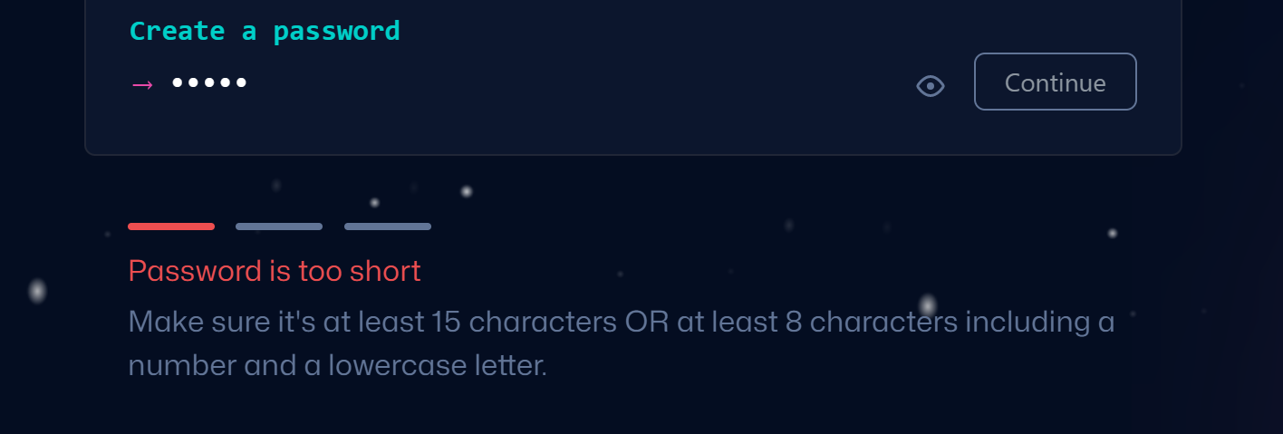
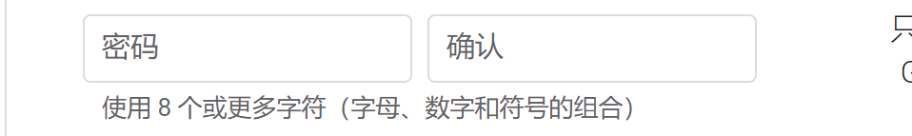
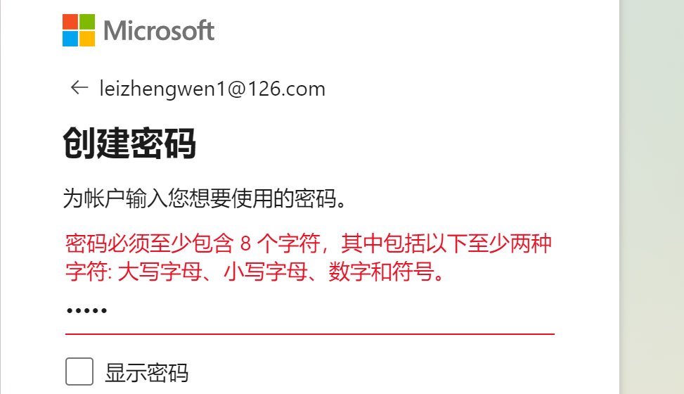
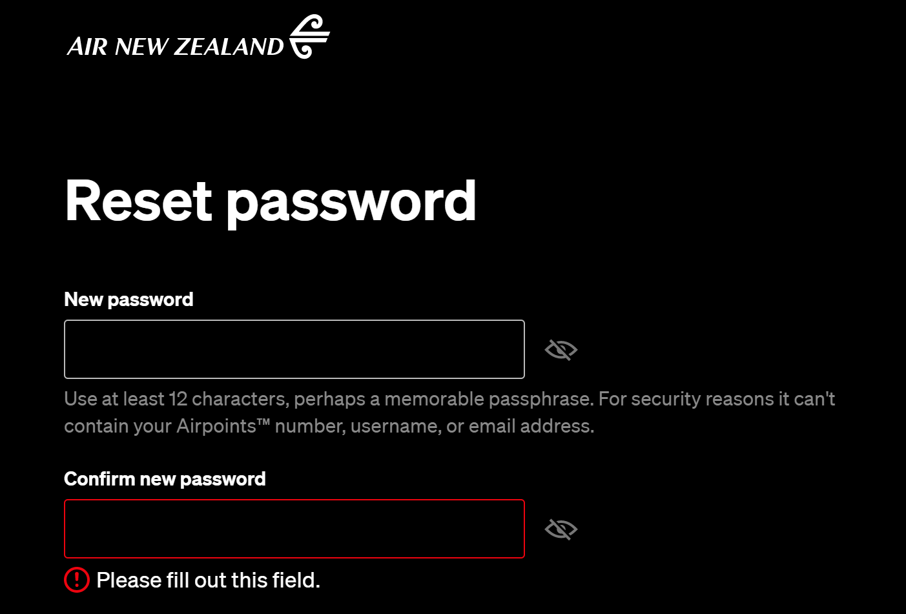
Why we choose this project
Hard to create an ideal password

Slide 5
Why we choose this project
Unlikely to create a strong password
123456,1234567890
qwert, qwertyuiop
123456qwerty, 1qaz2wsx

Slide 6
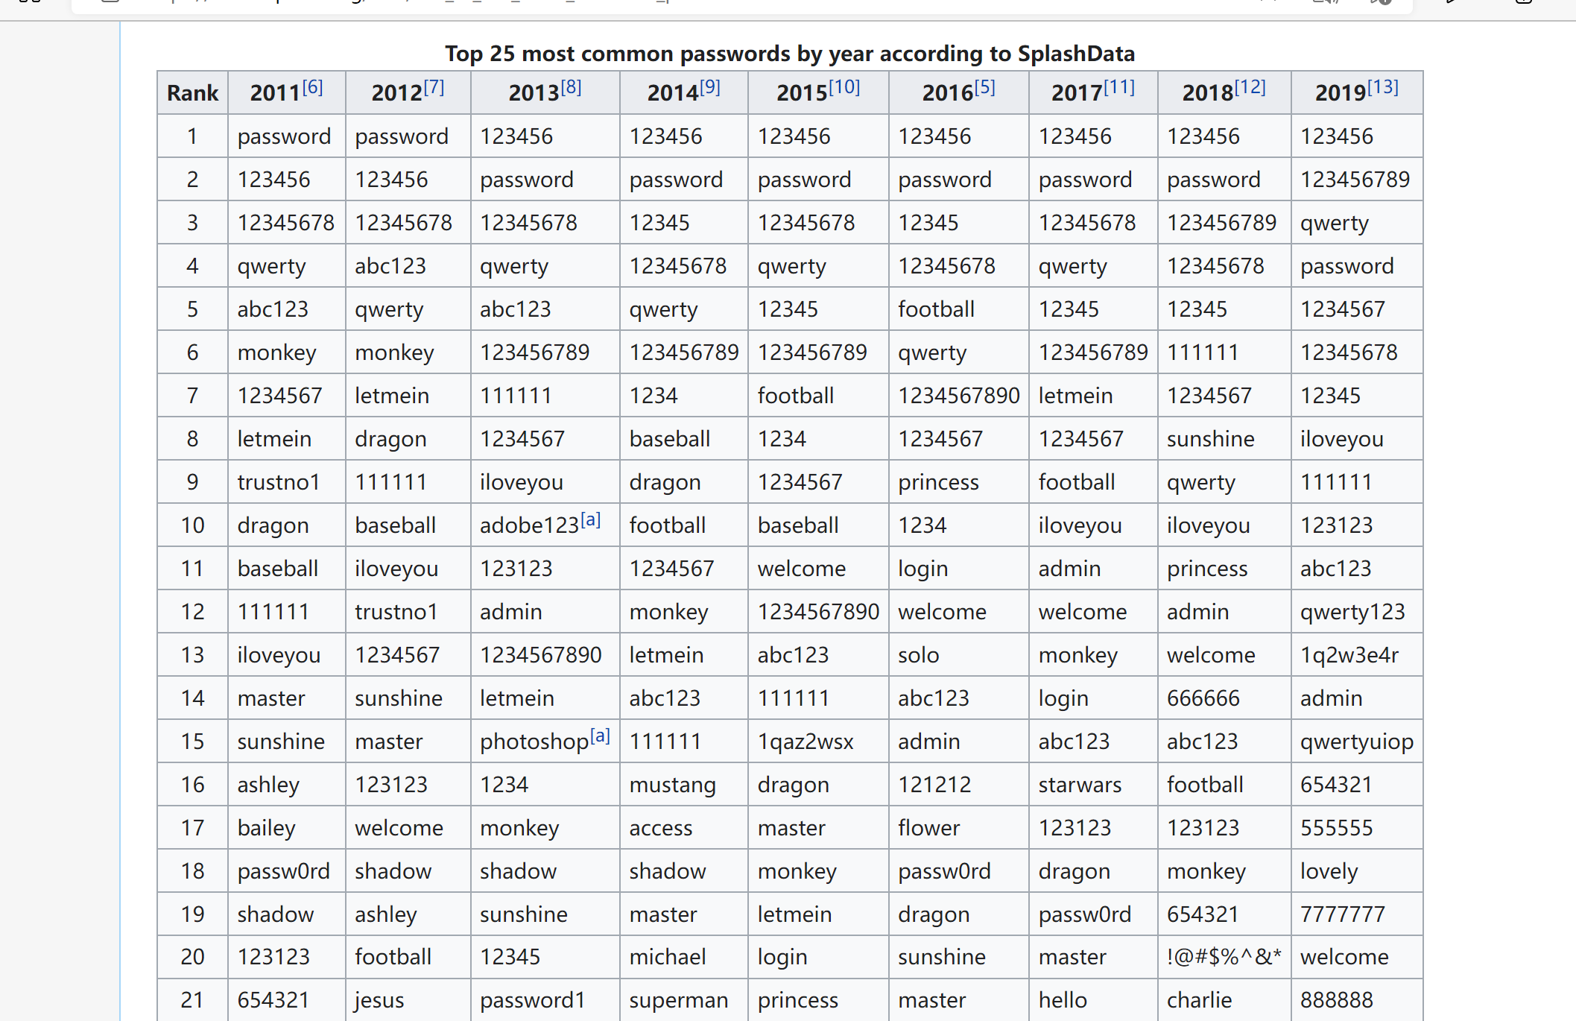
Retrived from: List of the most common passwords - Wikipedia

Slide 7
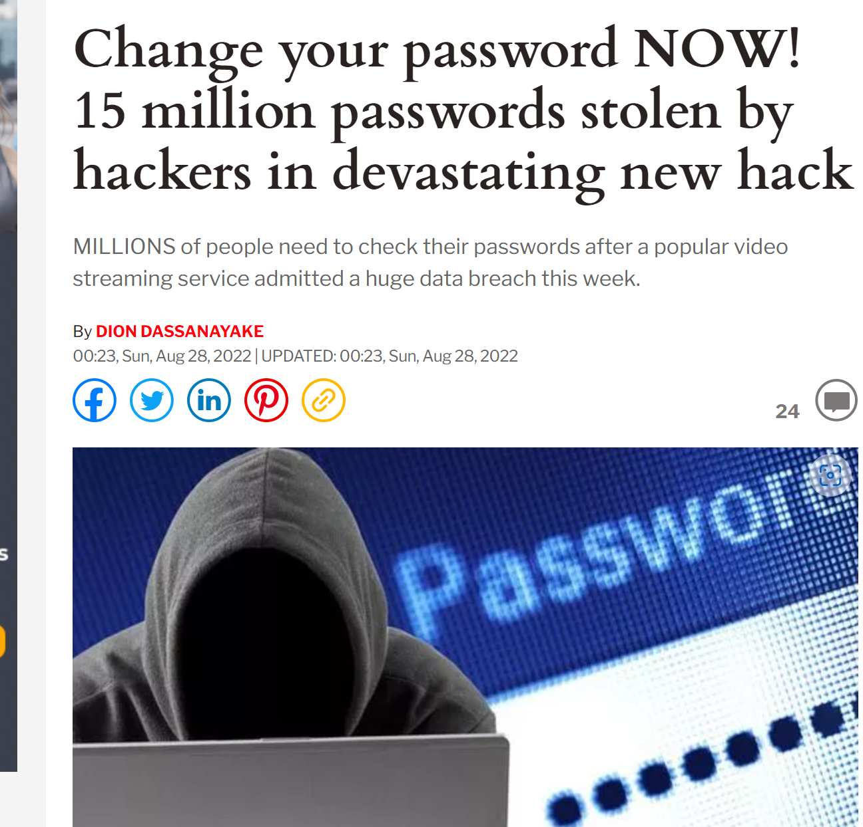
Risks of password leaking
1. Private information exposure
2. Money loss
3. Risks of ID frauds
Retrived from: Change your password NOW! 15 million Plex passwords stolen by hackers | Express.co.uk

Slide 8
Technologies
Web base software
Tools: Apache, Nodejs
Modules: express, ejs, cookie-parser
Languages: Javascript, Javascript( embedded ), Html, css
Request method: POST / GET

Slide 9
methodology
4 reasons for using waterfall methodology
The requirements are explicit.
Relatively simple system.
Only be used in certain circumstances
Unlikely to be changed.
1. Allow input of various input parameters on password such as Password Length, Include Symbols, Numbers, Lower/Upper case Characters, etc
2. Save the above parameter :( save all the settings above for later use)
3. Generate a random password for based on the above parameters
4. Copy function to copy the generated password to the buffer (like Control + C)
Retrived from: project list

Slide 10
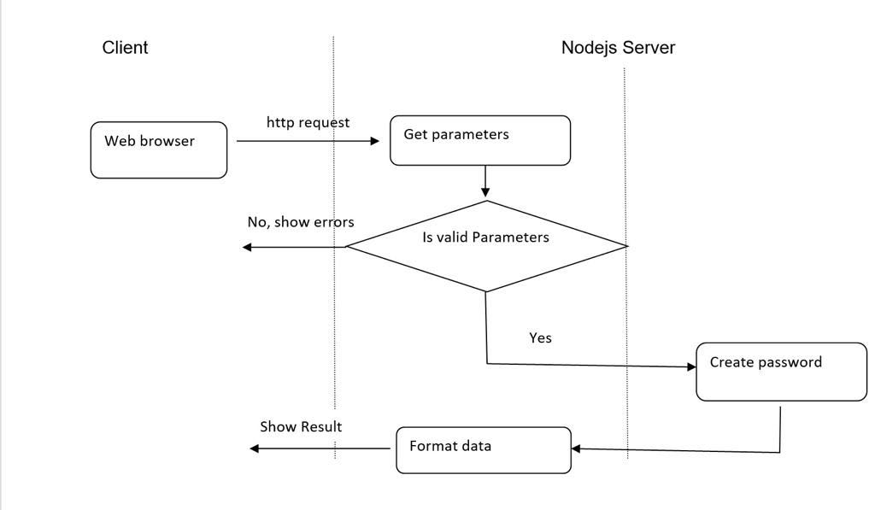
TEAM WORK

Slide 11
TEAM WORK
Client (Richard)
User Interface (Html/ejs, css, embedded javascript)
Server (Steven)
request process (javascript)
. Cookies process (javascript)
Server( Maribeth)
implement of the module - Password Generator (javascript)

Slide 12
Reflections
Maribeth:
Richard:
Steven:

Slide 13
References

Slide 14
Q&A
Answer Questions

